Slide 1


Programming the Geiger Counter Board

Slide 2
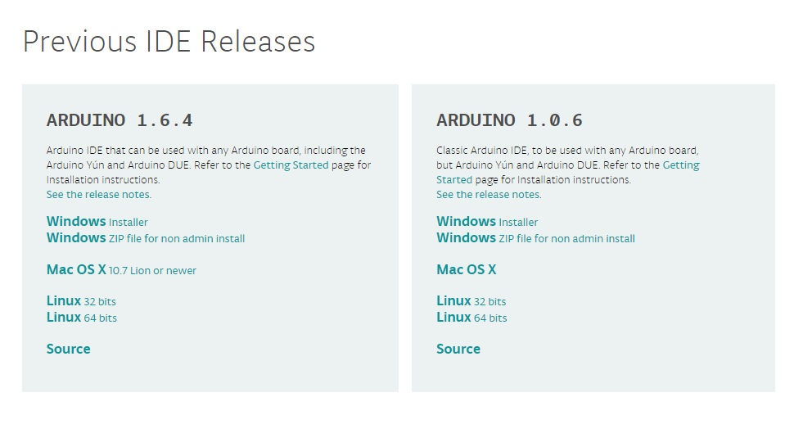
Arduino Files
Go to https://www.arduino.cc/en/Main/OldSoftwareReleases#previous and download the latest Arduino 1.0.X version (ex. 1.0.6) to your desktop
Download SDFormatterv4:
https://www.sdcard.org/downloads/formatter_4/
Download Radiation-Logger-1.4.1.0:
http://www.rhelectronics.net/store/radiation-logger.html
**It is recommended to use google chrome to install these items
Choose either “Windows Installer” or “Mac OS X” depending on your computer type

Slide 3
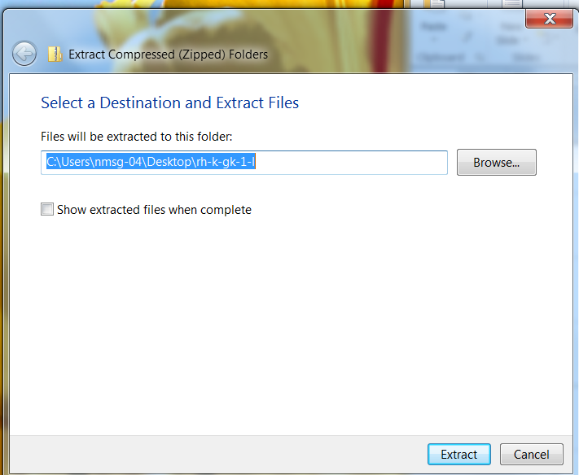
Arduino Files Cont.
NMSGC will provide a programing folder. Save the provided folder (1.01-L) onto your desktop
Extract the zip files by
right clicking on them
then clicking “Extract All…”
Choose the destination
for the files to be saved
then click “Extract”

Slide 4
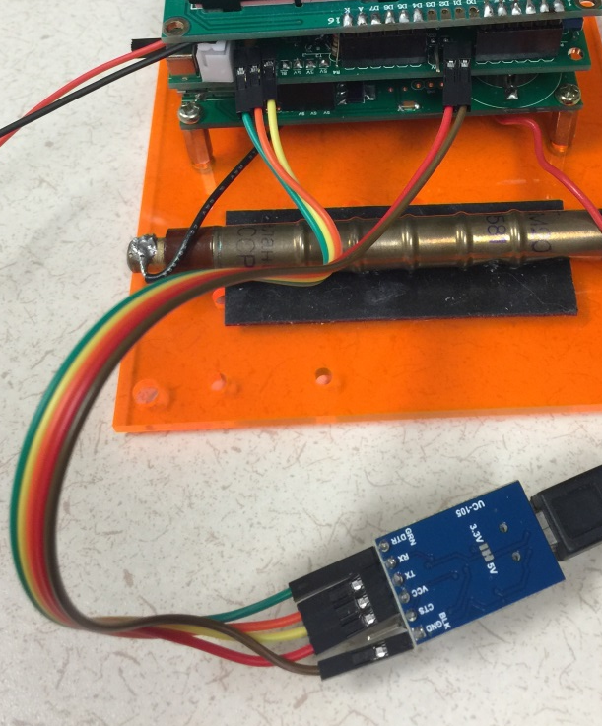
Connecting the Board
Connect all 5 wires from the Main Board to the Adapter Board:
GND to GND
5V to VCC
TX to TX
RX to RX
RS to DTR
Connect the Adapter Board to the computer using the mini SD cable

Slide 5
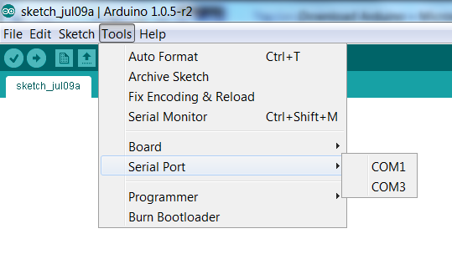
Using Arduino 1.0.X
Open Arduino 1.0.X
Click on the “Tools” tab and check these three things:
Board: should be Arduino Uno
Programmer: should read AVRISP mkII
Serial port: click on correct port (ex: COM 3)

Slide 6
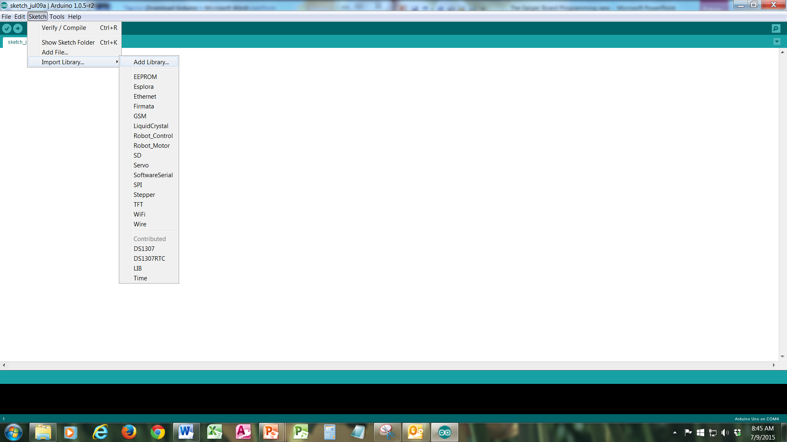
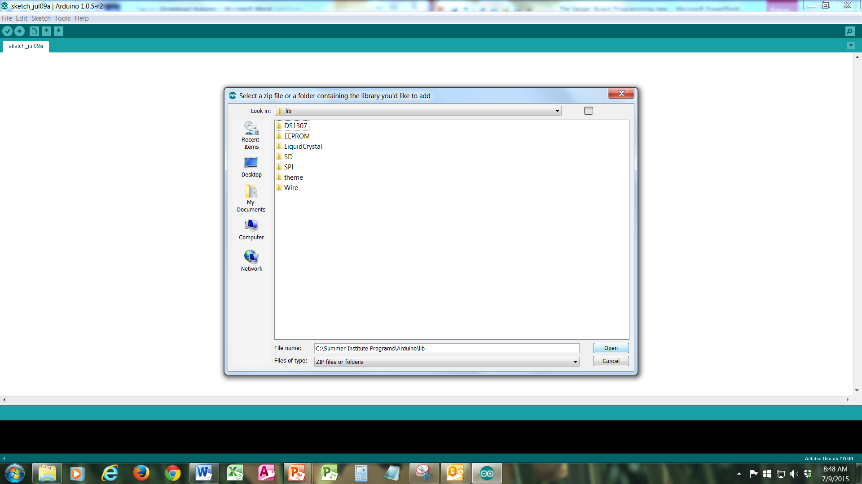
Updating the Libraries
We need to first update the library
In Arduino, click sketch>import library>add library…
Search for the “LIB” file located in the “1.01- L” folder you saved earlier and click on it then click “Open”. This library is now in Arduino.
If you have more questions here is the link to a help guide http://arduino.cc/en/Guide/Libraries

Slide 7
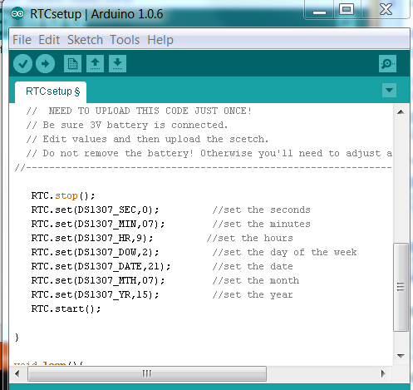
Programming the Board
In Arduino click File>Open>1.01L>RTCsetup>RTCsetup
The “RTCsetup” code
should be open
Scroll down the code
and enter the correct
date and time

Slide 8
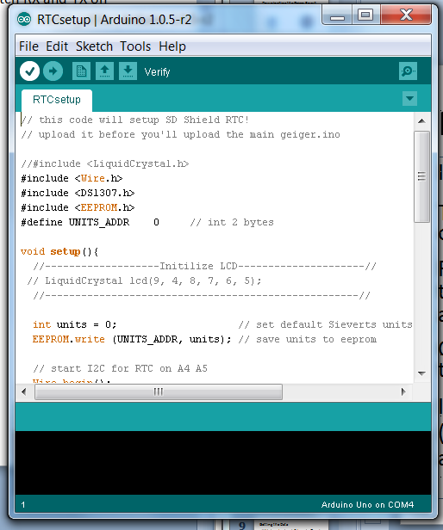
Programming the Board cont.
Right below the “File” tab at the
top, you will see a check mark with
an arrow next to it
Click on the check mark and verify
the code
If no errors appear, click the arrow
and upload the code (If an error code appears switch RX and TX pins on the Main Board and retry)
Once complete, close the RTCsetup window

Slide 9
Programming the Board cont.
In Arduino click File>Open>1.01-L>rh-k-gk-1-l>geiger>geiger
The “geiger” code should be open in Arduino and should display two tabs labeled “geiger” and “Configuration.h”
In the “geiger” tab click on the check mark and verify the code
Once verified, click the arrow and upload the code (If an error code appears switch RX and TX pins on the Main Board and retry)
Switch tabs to “Configuration.h” , then verify and upload the code
Once complete, close the program, unplug the Adapter Board from your computer and unplug the colored wires from the Main Board.

Slide 10
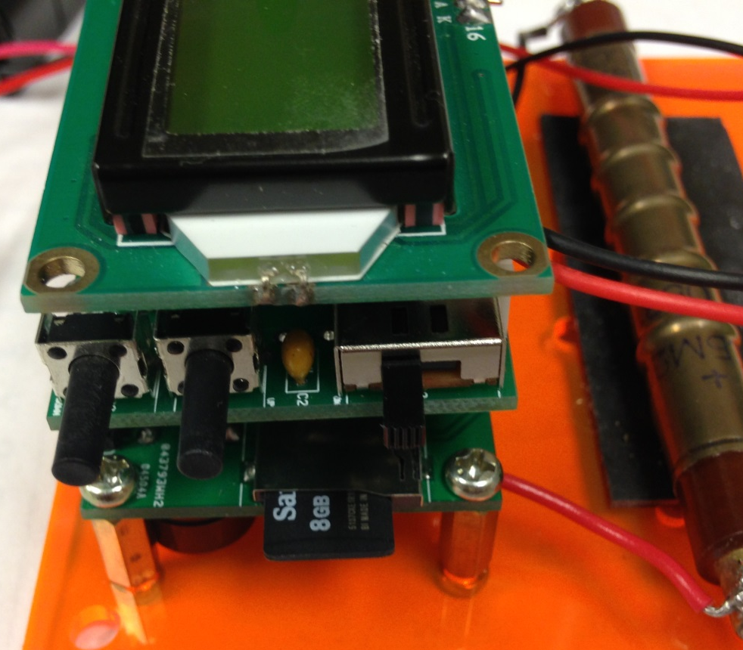
Getting the Data
With the Geiger Board off, insert the Micro SD card
Turn the Geiger Counter on
It will automatically
start saving data to
Micro SD card
ON OFF

Slide 11
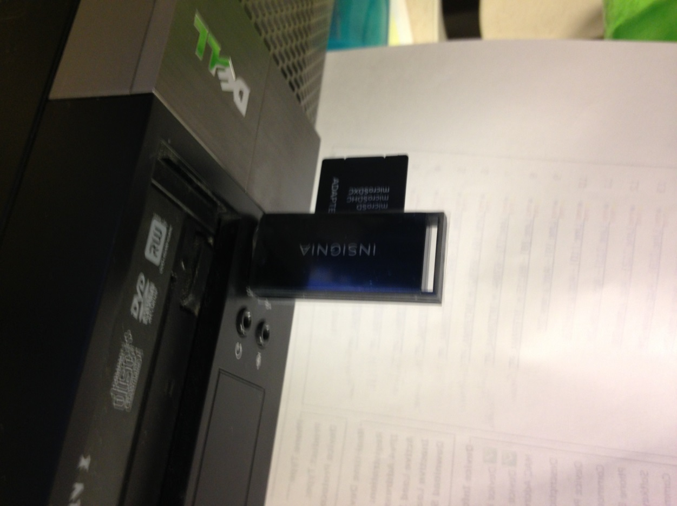
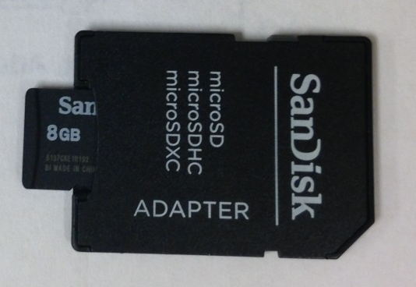
Getting the Data cont.
Once testing is complete turn Geiger Board off and remove Micro SD card
Insert Micro SD card into the computer using the SD adapter
Open the data file and copy/paste into excel

